Slide 1
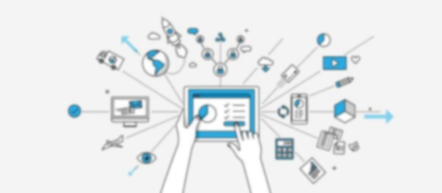
IoT Session 11
Dr Faisal Iradat

Slide 2
LAN
Local Area Networks, or LANs, are the “physical” networks that provide the connection between machines
home, school or corporation
LANs are, as the name says, “local”
IP (Internet Protocol), layer that provides an abstraction for connecting multiple LANs into the Internet
TCP deals with transport and connections and actually sending user data

Slide 3
Layered Model
Four-layered model
Application; Transport; Network; Link
Each layer can be perceived as a programming interface or library
Similar to function calls
A layer can communicate directly with one above or below it

Slide 4
Link Layer
In charge of actual delivery of packets
Conceptually subdivided
Physical layer
analog electrical, optical or radio signaling mechanisms
Logical Layer
all the digital (non-analog – operations on packets)
Application
Transport
Network
Logical
Physical

Slide 5
Internet five-layer Model
Physical/logical division gives us the Internet five-layer model
Less a formal hierarchy as an ad hoc classification method

Slide 6
Data Rate, Throughput and Bandwidth
Data Rate
rate at which bits are transmitted
Throughput
overall effective transmission rate
measured at a higher network layer than the data rate
Bandwidth
Refer to either data rate or throughput
Synonym for data rate
Goodput
refer to what might also be called “application-layer throughput”
amount of usable data delivered to the receiving application
retransmitted data is counted only once
retransmitted data counted twice under some interpretations of “throughput”

Slide 7
Packets
Modest-sized buffers of data
transmitted as a unit through some shared set of links
Prefixed with a header
delivery information
Common case known as datagram forwarding
Header
destination address
headers in networks using so-called
Virtual-circuit forwarding contain instead an identifier for the connection
Networking today is packet-based
Circuit switched – telephony network

Slide 8
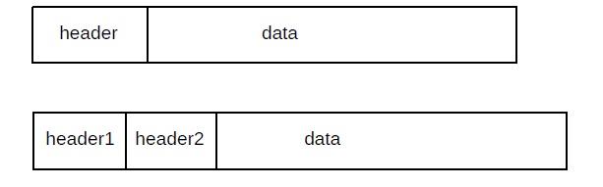
Header
LAN layer
Packets can be viewed as buffer
Packets are often referred to as frames at the LAN layer
Segments at the Transport layer

Slide 9
Packet Size
Ethernet
Maximum of 1500 bytes of data. By comparison, TCP/IP packets
MTU (Max. Trans. Unit) is 1500 bytes
Largest IP packet (or some other payload) an Ethernet frame can contain is 1500 bytes
Additional 26 bytes for the Ethernet header results in a maximum frame (not the same as MTU) of 1526
TCP/IP packets originally often held only 512 bytes of data
Token Ring packets could contain up to 4 kB of data.
Proponents of very large packet sizes, larger even than 64 kB
ATM (Asynchronous Transfer Mode) protocol uses 48 bytes of data per packet

Slide 10
Packet Size Contd…
Ethernet headers
14 bytes
IP headers
20 bytes
TCP headers
20 bytes
Lets say if TCP connection sends 512 bytes of data per packet, then the headers amount to _______% of the total
Voice-over-IP
160 bytes of data
54 bytes of headers
making the header about _______% of the total
Compressing the 160 bytes of audio, however, may bring the data portion down to 20 bytes, meaning that the headers are now ___% of the total
Notes:
10% [54/(34+516)]
25% [54/(160+54)]
73% [54/(54+20)]

Slide 11
VoIP
RTP (Realtime Transfer Protocol) header: 12 bytes
UDP (User Datagram Protocol) header: 8 bytes
IP (Internet Protocol) header: 20 bytes
Ethernet header: 14 bytes

Slide 12
Datagram
RFC 1594 defines the term Datagram as follows:
“A self-contained, independent entity of data carrying sufficient information to be routed from the source to the destination computer without reliance on earlier exchanges between this source and destination computer and the transporting network.”

Slide 13
Datagram Forwarding
Packet headers contain a destination address
Switches or routers
look at this address and get the packet to the correct destination.
Datagram forwarding
Providing each switch with a forwarding table <destination, next_hop> pairs.
looks up the destination address (presumed globally unique) in its forwarding table
finds the next_hop information: the immediate-neighbor address to which the packet should be forwarded
bring it one step closer to its final destination.
The next_hop value in a forwarding table is a single entry
Switches delivers the packet, one hop at a time, to its ultimate destination
IP routing
table “destination” entries will correspond to prefixes of IP addresses
Huge savings in space
Fundamental
Switch can perform a lookup operation

Slide 14
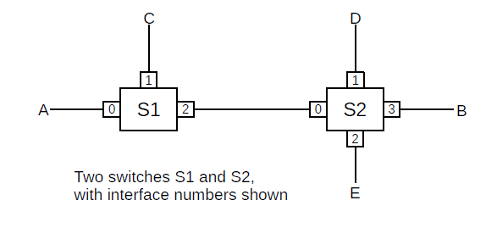
Example

Slide 15
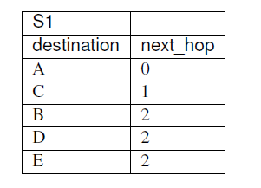
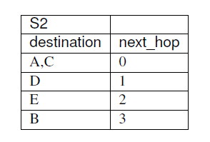
Example Contd…

Slide 16
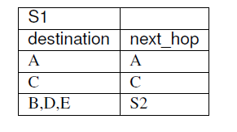
Example Contd..

Slide 17
Datagram Forwarding
Datagram Forwarding
each packet is forwarded “in isolation”
switches involved do not have any awareness of any higher-layer logical connections
also called stateless forwarding
RFC 1122
To improve robustness of the communication system, gateways are designed to be stateless, forwarding each IP datagram independently of other datagrams. As a result, redundant paths can be exploited to provide robust service in spite of failures of intervening gateways and networks.
The fundamental alternative to datagram forwarding is virtual circuits

Slide 18
Virtual Circuits
Each router maintains state about each connection passing through it
Different connections can be routed differently
Datagram forwarding is sometimes allowed to use other information beyond the destination address
In theory, IP routing can be done based on the destination address and some quality-of-service information
e.g. different routing to the same destination for high-bandwidth bulk traffic and for low latency real-time traffic

Slide 19
Confusing..Not any more
By convention
Devices acting at the LAN layer and forwarding packets based on the LAN address are called switches (or, originally, bridges; some still prefer that term)
Deices acting at the IP layer and forwarding on the IP address are called routers.
Datagram forwarding is used both by Ethernet switches and by IP routers
Destinations in Ethernet forwarding tables are individual nodes while,
destinations in IP routers are entire networks (that is, sets of nodes)

Slide 20
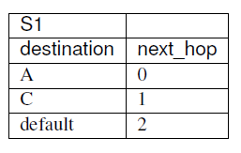
IP Routers
Notes:
catchall

Slide 21
Topology
So far…there are no loops… graph theorists might describe the network graph is acyclic, or is a tree
Loop-free network there is a unique path between any pair of nodes
Forwarding-table algorithm
every destination appears in the forwarding tables; the issue of choosing between alternative paths does not arise
No loops then there is no redundancy
any broken link
Partitioning the network into two pieces that cannot communicate
Redundancy is a good thing
make decisions among the multiple paths to a destination

Slide 22
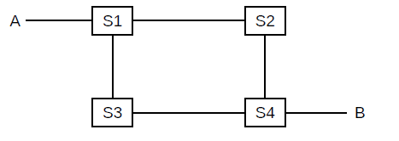
Topology Contd…

Slide 23
Traffic Engineering
Any intentional selection of one route over another, or,
any elevation of the priority of one class of traffic
Route selection can either be
directly intentional,
through configuration, or,
can be implicit in the selection or tuning of algorithms that then make these route-selection choices automatically

Slide 24
DVRP
Distance-Vector Routing-Update Algorithm
Build forwarding tables on their own, but those tables are greatly influenced by the administrative assignment of link costs
QoS example
At the LAN layer
traffic-engineering mechanisms are historically limited, though, Software-Defined Networking
At the IP layer, more strategies are available

Slide 25
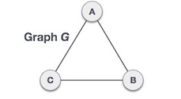
Spanning Tree
A spanning tree is a subset of Graph G, which has all the vertices covered with minimum possible number of edges
A spanning tree does not have cycles and it cannot be disconnected

Slide 26
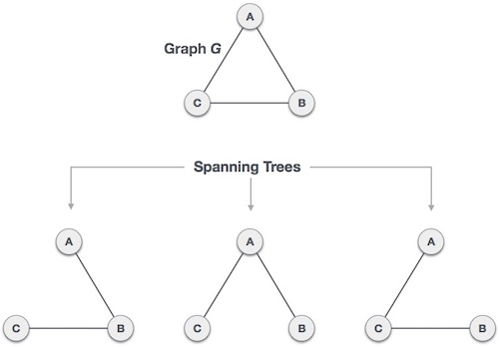

Spanning Tree
$n^{n−2}$

Slide 27
ST Properties
A connected graph G can have more than one spanning tree
All possible spanning trees of graph G, have the same number of edges and vertices
The spanning tree does not have any cycle (loops)
Removing one edge from the spanning tree will make the graph disconnected, i.e. the spanning tree is minimally connected
Adding one edge to the spanning tree will create a circuit or loop, i.e. the spanning tree is maximally acyclic

Slide 28
Reading Assignment
Spanning tree
TRILL
SPB

Slide 29
SDN
Software-Defined Networking
The core idea of SDN is to place the forwarding mechanism of each participating switch under the aegis of a controller, a user-programmable device that is capable of giving each switch instructions on how to forward packets
The controller can be a single node on the network, or can be a distributed set of nodes
The controller manages the forwarding tables of each of the switches

Slide 30
SDN
Software Defined Networking (SDN) is changing the way we design and manage networks
First, an SDN separates the control plane (which decides how to handle the traffic) from the data plane (which forwards traffic according to decisions that the control plane makes)
Second, an SDN consolidates the control plane, so that a single software control program controls multiple data-plane elements

Slide 31
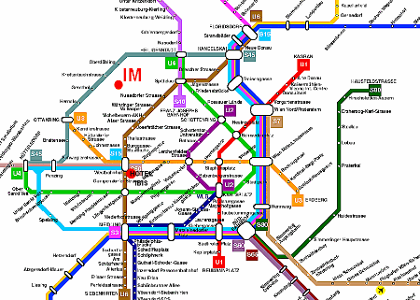
Control-plane vs Data-plane

Slide 32
Control-plane vs Data-plane
Control Plane = Learning what we will do
Planning stage
learning which paths the buses will take, is similar to the control plane in the network
We haven't picked up people yet, nor have we dropped them off, but we do know the paths and stops due to our plan
The control plane is primarily about the learning of routes.
Routed network
Planning and learning can be done through static routes
Dynamic routing protocols, like RIP, OSPF and EIGRP to allow the routers to train each other regarding how to reach remote networks
This is all the control plane.
Data Plane = Actualy moving the packets based on what we learned.
Routers know how to route for remote networks
comes a customers packet and BAM! this is were the data plane begins
The data plane is the actual movement of the customers data packets over the transit path

Slide 33
Historical Perspective
SDN
How we design and manage Networks
Making networks more programmable
OpenFlow & Network O/S
SDN and NV
Debunked common myths

Slide 34
Road to SDN
Networks
Routers
Switches
Middleboxes
Firewalls
NAT
Load balancers
Intrusion Detection Systems

Slide 35
Road to SDN
S/W implements network Protocols
Network administrators
configure individual network devices using configuration interfaces that vary
across vendors
and even across different
Network management tools
offer a central vantage point for configuring the network
Limitations
Systems still operate at the level of individual protocols, mechanisms, and configuration interfaces
This mode of operation has slowed innovation, increased complexity
Inflated both the capital and operational costs of running a network

Slide 36
Road to SDN
SDN has two defining characteristics
First, an SDN separates the control plane (which decides how to handle the traffic) from the data plane (which forwards traffic according to decisions that the control plane makes)
Second, an SDN consolidates the control plane, so that a single software control program controls multiple data-plane elements

Slide 37
Control Plane
Makes decisions about where traffic is sent
Control plane packets are destined to or locally originated by the router itself
The control plane functions include the system configuration, management, and exchange of routing table information
The route controller exchanges the topology information with other routers and constructs a routing table based on a routing protocol, for example, RIP, OSPF or BGP
Control plane packets are processed by the router to update the routing table information.
It is the Signalling of the network
Since the control functions are not performed on each arriving individual packet, they do not have a strict speed constraint and are less time-critical

Slide 38
Data Plane
Also known as Forwarding Plane
Forwards traffic to the next hop along the path to the selected destination network according to control plane logic
Data plane packets go through the router
The routers/switches use what the control plane built to dispose of incoming and outgoing frames and packets

Slide 39
Example
R1, R2 and R3
Telnet
R1 and R3
Control/management plane
R2
Data plane traffic

Slide 40
Road to SDN
How does the control plane exercise its control over the state in the networks data plane elements?
API
OpenFlow
OpenFlow Switch
has one or more tables of packet-handling rules
each rule matches a subset of traffic and performs certain actions on the traffic that matches a rule
actions include
dropping
forwarding
Flooding
Depending on the rules installed by a controller application
OpenFlow switch can behave like a router, switch, firewall, network address translator, or something in between

Slide 41
Road to SDN
Initial Vendors
HP, NEC and Pronto
Controller platforms
Beacon OpenFlow
FloodLight
NOX
ONOS
POX
Nettle

Slide 42
Road to SDN
Applications using these platforms
Dynamic Access Control
Server Load Balancing
Network Virtualization
Energy Efficient Networking
Seamless Virtual Machines
Migration and User Mobility

Slide 43
Road to SDN
Commercial Success
Google’s wide-area traffic-management system
Nicira’s Network Virtualization Platform
Consortia
Open Networking Foundation and
https://www.opennetworking.org
Open Daylight initiative
https://www.opendaylight.org

Slide 44
Road to Research in SDN
Evolution of key ideas
Application “pulls” and technology “pushes” of the day
Lessons that can help guide the next set of SDN innovations

Slide 45
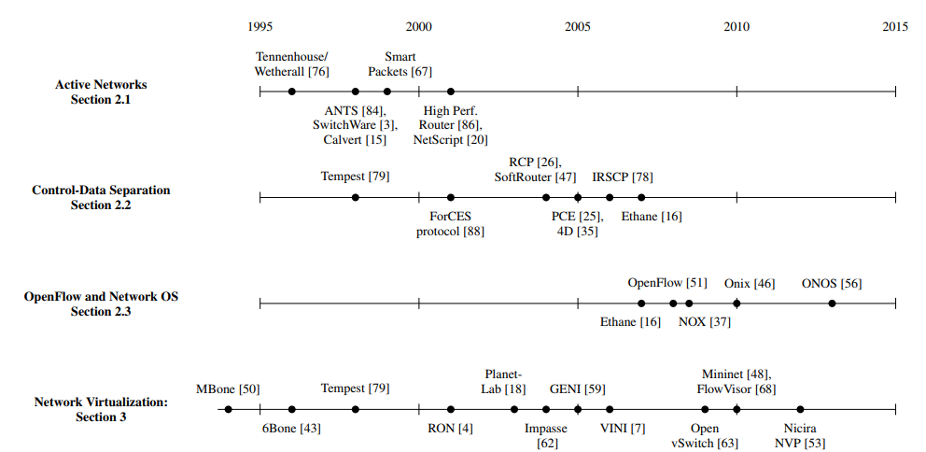
Roadmap

